Slide 1
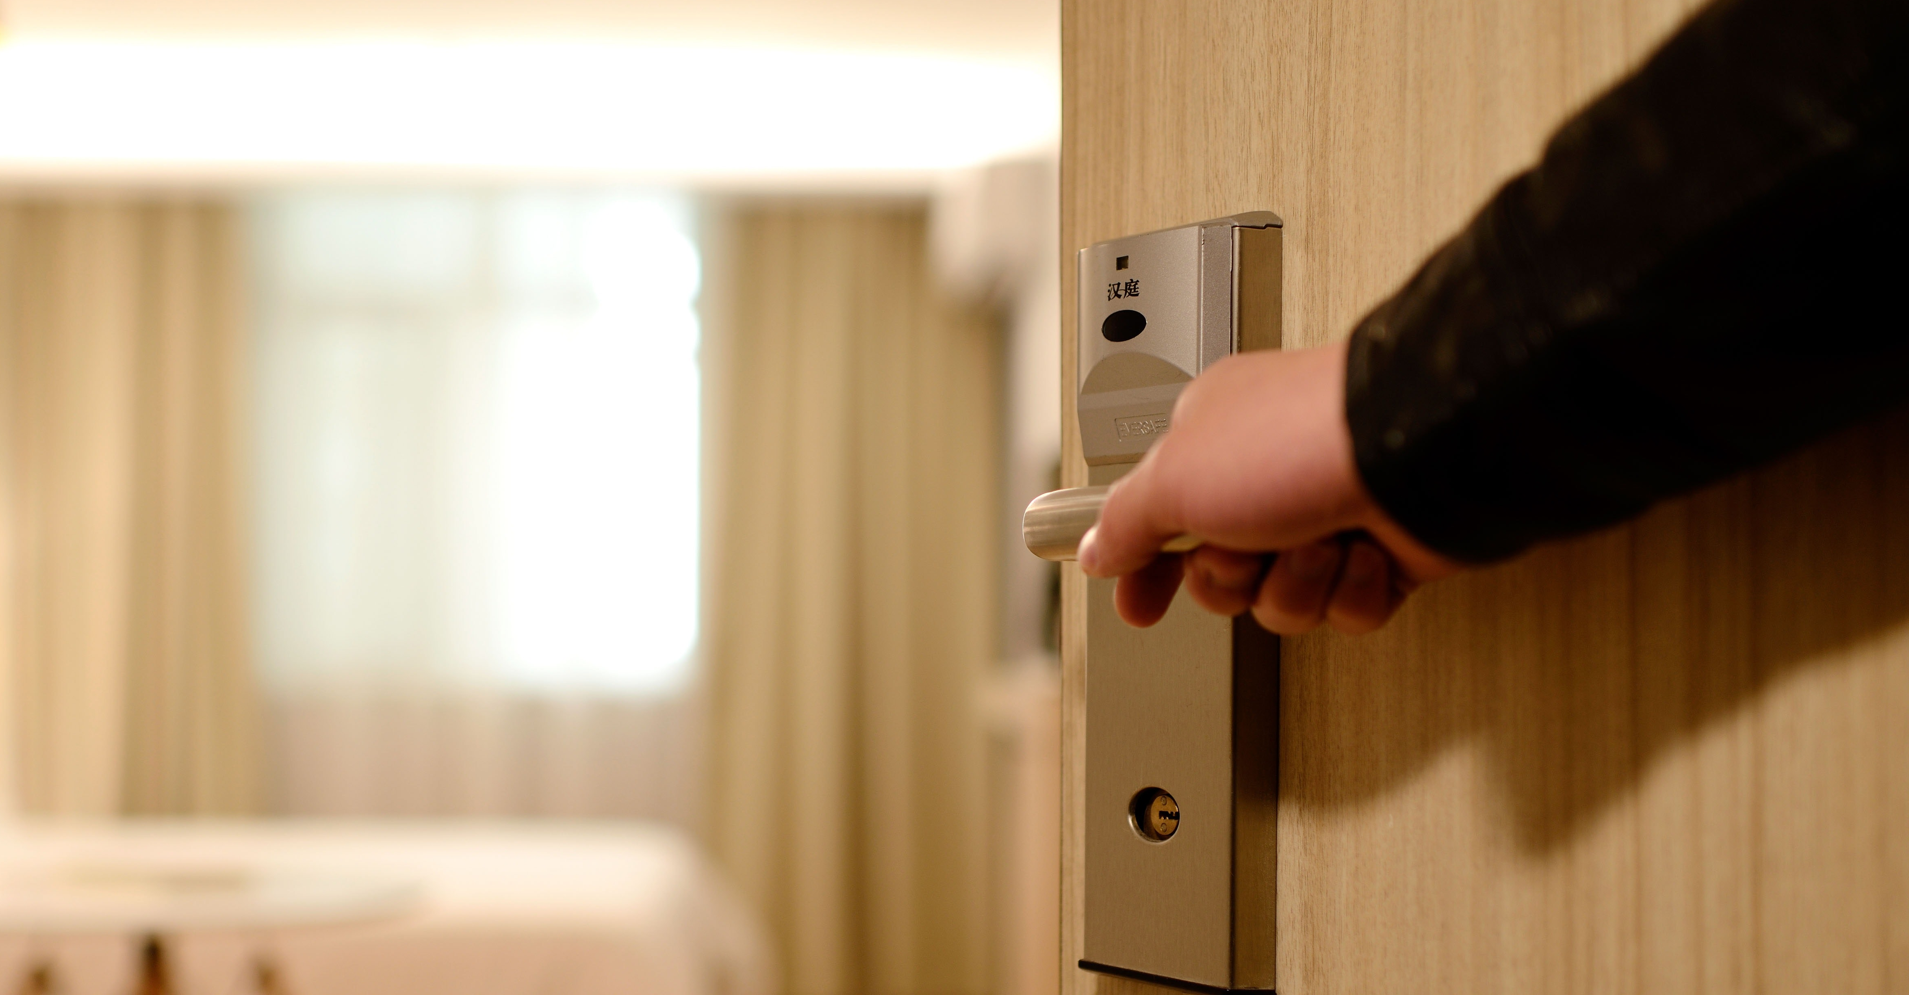
Preventing Modern Slavery in Hotels During Covid-19
Notes:
STT introduction
Why you are watching this video and what it will tell you
For all staff
Responsibilities of emergency accommodation staff
Prevalence of Modern Slavery
Methods of control & coercion
Types & signs of exploitation
How to report an incident
For homeless services staff:
Questions to ask someone you might suspect is being exploited
Steps to supporting a survivor of exploitation

Slide 2
What are we asking of you?
We are asking you to:
Know what modern slavery is
Learn the signs that you might see in your job
Know how to report concerns
For support organisation staff – know the steps to support potential victims
Hotel staff do not have a responsibility to stop modern slavery.
Hotel staff are not the police, they should not investigate or question residents.
We are just asking you to be aware of the problem, have professional curiosity and, if you think something is wrong, tell someone who is responsible for stopping modern slavery.
Notes:
We are all aware of the impact that the corona virus has had on our lives.
The housing of people who are currently homeless in hotels will definitely have a positive impact, but we also need to be aware of the risks of exploitation occurring.
It is an opportunity to engage many individuals who have historically been completely isolated from services.
Working in the hotels, you are the eyes and ears, you might spot something that nobody else can.
We are asking you to know what exploitation, know how to spot it, and know how to report it.
Everyone in the community has a responsibility to stop modern slavery but it is also important to remember you are not the police! Never confront anyone and never put yourself at risk.
All we are asking you to do is keep your eyes open and if you do see something that feels strange or doesn’t sit right with you, tell someone who can do something about it.
This training is primarily aimed at the hotel staff, but we understand that other organisations will also be using it.
Staff from support organisations will have different background knowledge and your safeguarding responsibilities will be different. We have some extra information for staff from support organisations in the last 2 slides which explores how to achieve the fourth step – supporting potential victims.

Slide 3
Who is affected by modern slavery?
In 2019, 10,627 survivors of modern slavery were identified and supported in the UK
1 in 4 victims were British
1 in 3 victims were female and 2 in 3 victims were male
Half of the victims were adults and half were children
The UK Government estimates there are up to 13,000 victims in the UK at one time
Modern slavery targets the vulnerable, and that includes the people experiencing homelessness
1 in 5 homeless people in Manchester know someone who has disappeared after accepting work that only pays in food or housing
1 in 10 homeless people in London have experienced modern slavery
Notes:
Unfortunately modern slavery affects all elements of our society
As you can see nearly 11,000 victims were supported last year in the UK.
Many people think it must only happen to people from other countries, and although other nationalities are affected, the most common nationality of the victims identified last year was British.
It affects children and adults, men and women. It can affect anyone.
But unfortunately these survivors were the tip of the iceberg, the government estimates there are up to 13,000 victims in the UK at one time, with other estimates ranging as high as 136,000
Modern slavery prays on the vulnerable, this includes people experiencing homelessness. Due to corona virus many homeless people have been cut off from their only means of making money unable to work and more difficult to beg, shoplift and sex work. This is only pushing people further into the control of their exploiters.
Research done by STT in Manchester found that 1 in 3 people accessing homeless services had received an offer of work in exchange for accommodation, drugs, food or alcohol and 1 in 5 know someone who disappeared after accepting this type of offer.
Similar research in London done by a charity called Hestia found that 1 in 10 people rough sleeping have experienced modern slavery
It is clear that throughout the country, people experiencing homelessness are at risk of modern slavery.
People experiencing homelessness are vulnerable to modern slavery because:
They might be desperate for any job, so might be persuaded to work for no or little money
They might have drugs dependency which exploiters can take advantage of it
They might not have a family network to rely on for support or to ask for help
They might not be identified as missing if they disappear as they are ‘hidden’ from our society
In order to access support, they might have to face environments with dangerous and predatory individuals

Slide 4
Matt’s Story
Rough sleeping at 19
Became in debt to his controllers
Befriended and offered housing
Forced into sex work and selling drugs
Encouraged to try harder drugs
Exploited for almost a year
Notes:
Matt, 19, a young man from Greater Manchester was rough sleeping after being kicked out of his family home. One day he was approached by a woman while begging. She gave him a drink and cigarettes and offered him a place to stay in return for a share of the money he made begging.
In the apartment Matt was given weed, then later as the woman and her associates encouraged him to escalate his drug use, crack and heroin. They told him he would pay it back later. After a couple of weeks, Matt owed them hundreds of pounds.
With no way to pay off the debt, the woman’s associates became violent and Matt was told he would have to sex work and sell drugs to pay back the money. He didn’t want to but he was scarred of what would happen if he didn’t and had no where else to go.
Matt was forced to sleep with so many men that he lost count, his substance use escalated and he lost all hope of ever being able to pay off the debt. This continued for almost a year until Matt built up enough trust with an outreach worker from a local charity who found him an alternative place to live and a place on a drug rehab project.

Slide 5
What is modern slavery?
Using deception or coercion
For the purpose of exploitation
Notes:
Firstly, we need to know what modern slavery is. Importantly, this is not about ‘ownership’ or ‘chains’, modern slavery is cleverer than that.
Modern slavery has a complicated legal definition with different elements, but you don’t need to know this.
What you need to know if that all cases of modern slavery include these two elements
This means that a victim is either tricked or forced to do something that another person gains from financially.
You might also hear the phrase ‘human trafficking’ – human trafficking and modern slavery are pretty much the same thing, so you don’t need to know the difference and can treat them as the same
We will now look into each of these 2 elements in detail

Slide 6
How are victims tricked or controlled?
Fake job offers which are too good to be true
Jobs and favours which only pay in food, housing, or drugs
Manipulating mental health issues, learning difficulties, trauma, social isolation & lack of family ties
Taking advantage of drug dependency
Using drugs as a reward or withholding them as punishment
Using or threatening to use violence
Threatening either the victim or their friends and family
Indebting victims by lending cash or drugs in ways which can never be paid off
Restricting access to finances
Emotional manipulation
Befriending or starting ‘loving’ relationships but then abusing their trust
Notes:
These deception and coercion techniques focus on the recruitment of people experiencing homelessness
Offering jobs and favours which are too good to be true are a common technique, but when it comes to people experiencing homelessness there is also evidence of exploiters offering jobs or asking for favours which only pay in food, housing or drugs.
In the past there has been evidence of exploiters picking up people experiencing homelessness from soup kitchens and targeting hostels and BnB’s, with these closed, we want staff at the hotels where homeless people are being housed to be aware they might be targeted instead – In some areas they already have!
Those with drug dependency issues are at a heightened risk as their addiction means they are can be taken advantage of – exploiters can make the victim do as they wish by controlling their access to drugs.
Victims may have borrowed money from exploiters and may be forced into committing crime/s, payment in kind and/or handling/storing drugs in order to repay their debt. Victims will generally pay more than double back what they have borrowed. Debts will increase even though victims are making payments.
Predatory individuals are experts at finding victims vulnerabilities and manipulating them for control, they could prey on socially isolated individuals with no family ties and prevent them from accessing support needed to escape their exploitation or take advantage of individuals with learning difficulties who might not understand fully that they are being exploited
Using violence, or threatening is also common. This might occur once the victim has started to be exploited, forcing them to stay out of fear even if they might be able to ‘escape’
Emotional manipulation, is common when exploiting minors but it can also happen to adults, particularly young people and people leaving care.
This can invovle the exploiter developing a ‘loving’ relationship with the victim, gaining their trust, before abusing their position and making them do things as part of their relationship.
Exploiters will also befriend their victims – part of the control of making sure they repay. Victims feels indebted to their friend who is really taking advantage of them.

Slide 7
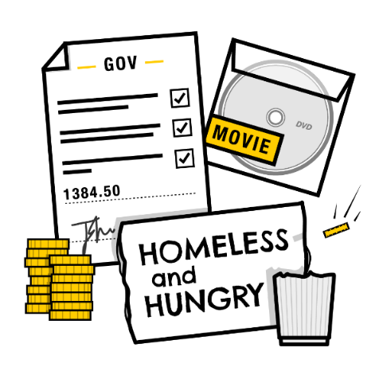
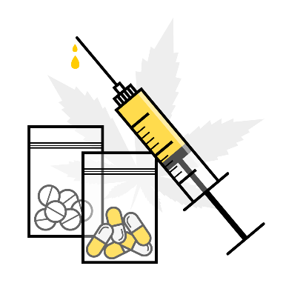
How are victims exploited?
Sexual Exploitation
On or off site
Victims might be forced to sell sex against their will and not receive the money. This does not include voluntary sex work
Labour Exploitation
Off site
Victims might be forced to work in sectors such as construction, agriculture, and manufacturing.
Criminal Exploitaiton
On or off site
Victim’s personal details might be used for benefits or financial fraud, they might be forced to beg, shoplift or commit violent crimes
Drugs Trade
On or off site
Victims might be forced to store, transport, grow, or sell drugs. This might occur inside or outside the hotel .
Notes:
When we talk about people experiencing homelessness there are four main types of exploitation we should be aware of.
Sexual exploitation, what you might know as sex trafficking, is when a victim, adult or child, female or male, is forced to perform sexual services and someone else gains financially. This might take place in brothels, but it can also happen in hotels or on the street.
Labour exploitation, what you might know as forced labour, is when a victim is made to work for none or very little money or reward. In the UK the common sectors this happens are construction, agriculture, food manufacturing, and cleaning.
Forced crime can often happen at the same time as other types of exploitation and might involve the victims details being used to commit fraud – although they will never see the money. Other types of forced crime include when victims are forced to shoplift or beg to pay off debt, sometimes victims will be forced to commit violent crimes – which is often related to the drugs trade.
Victims may have borrowed money from exploiters and may be forced into committing crime/s, payment in kind and/or handling/storing drugs in order to repay their debt. Victims will generally pay more than double back what they have borrowed. Debts will increase even though victims are making payments.
The drugs trade is closely linked with modern slavery. Many of you will have heard of county lines which involves minors and young adults being forced into transporting and selling drugs on behalf of gangs. Exploiters use victims so that they are never at risk of arrest, but they still keep the money. But adult victims can also be exploited in the drugs trade.
Unfortunately, STT has already had intelligence that the drug supply is getting into the hotels and that hotels have been targeted by loan sharks looking to make good on their debts

Slide 8
How might it occur in hotels during Covid-19?
Modern slavery can take many forms
For simplicity, we want you to be aware of 3 models of exploitation
Residents exploiting other residents
Exploiters trying to pick-up residents from the hotel
Victims transporting drugs into the hotels
None of these will be clear cut, there will always complexities and shades of grey, but we think its best that you have an idea of what might occur.
A common complexity is the distinction between a perpetrator and a victim being blurred.
Notes:
Although there are many ways modern slavery can occur, there are 3 ways exploitation might occur in hotels housing people who are currently homeless.
Its important to stress exploitation MIGHT occur, it isn’t definitely going to happen. But its worth being aware of it in case.
Firstly, residents might be exploiting other residents. For example, one resident might be forcing another resident to perform sexual acts for money within the hotel. This can be done by and to both men and women.
You might notice the signs of frequent sex when in the rooms or you might see multiple residents visiting one room walking around the corridors.
Secondly, as we’ve already mentioned, hotels where people who are homeless are being housed during the lockdown might be targeted by exploiters who want to pick up new victims.
You might see vans or people hanging around near the entrance to the hotel talking to residents, maybe trying to befriend them by offering them money, drugs, or food. Or residents might be picked up and dropped off each day by the same car or van. Theses exploiters might be recruiting for sexual or labour exploitation.
Finally, the residents might not be the only victims on site, victims of modern slavery might also be delivering drugs to the residents.
For example, you might see vulnerable people people or minors visiting the site to meet multiple residents, they might be forced to deal by criminal gangs who could often be nearby.
Unfortunately when it comes to modern slavery there aren’t clear cut groups of perpetrators and victims – in fact the distinction can often be blurred. Exploitation can sometimes be a means of survival for people on the street where drugs have such force over many people’s lives and sometimes only the option of exploiting someone else can prevent and individuals own victimisation.

Slide 9
How can you spot modern slavery?
General Signs of Exploitation
Large amounts of cash in room | Residents mention their benefits are going to others
A resident mentions they owe money | A resident is always accompanied by another
Drugs found in a room or around hotel | Residents show signs of trauma
Strangers at the hotel demanding money or favours | Strangers trying to enter the premises
Residents with signs of assault or abuse | Residents won’t say where they are going
Multiple visitors to one room | Residents receive gifts
Targeting younger residents ‘taking under their wing’ | Residents picked up & dropped off from the hotel
Notes:
Modern slavery is a complicated crime, it relies of subtle psychological control of victims which isn’t always obvious.
However, there are some signs which you should be aware of. These behavioural cues can indicate that exploitation is happening.
(Talk through the signs on the slide)
Noticing one of signs doesn’t prove modern slavery is happening. In fact, it could be a sign of something completely innocent. For example, taking someone under their wing could be someone generally trying to help
However, once you see two or three of these signs you should definitely report your concerns to someone who has the responsibility to safeguard the residents.
Remember, unless you are a support worker you should not investigate or question residents. Never confront someone you suspect of exploitation. Do not put yourself in harms way.

Slide 10
How can you spot modern slavery?
Sexual Exploitation | Criminal Exploitation | Labour Exploitation | Financial Exploitation
A resident requests more bedding or towels | Young or vulnerable people visiting the hotel frequently | Strangers hanging around outside the hotel, trying to befriend residents | Resident may not have any money the day their benefits are paid
Resident leaves the hotel at night, especially if picked up/dropped off | Violence and threats within the hotels between groups of residents | Leaving the hotel for long periods of time during the day or at night | Resident may show increased worry/panic on certain day of the week
Multiple used condoms in a room | Residents mention ‘bullying’ or intimidation | Residents mentioning payment in drugs or alcohol | Resident may not have access to own money/benefits/bank card
Signs of a controlling or abusive relationship | Finding weapons within the accommodation | Being picked up in vehicle from outside the hotel | Resident leaves hotel after receiving a call
Frequent visitors to the same hotel room throughout the day or evening. | Young residents joining group of older, long-term homeless individuals
Notes:
Further to the general signs, there are other things you might see which indicate a specific form of exploitation. It is important to remember that often people are exploited in several different ways by their traffickers and you shouldn’t discount other forms if you see signs of one.
[Read through signs]
Opportunistic sex work/begging more vulnerable than on street: Women who are begging and approached for sex are less able to consent than beat sex workers, no option of safe sex, sometimes alone, naïve less aware and experienced
Sexual exploitation and sexual abuse are a particular threat in mixed sex accommodation where women may feel forced to partner up with a male for protection who may develop exploitative behaviour.
It is also a danger in a women’s only accommodation through risks posed through from older less vulnerable residents to younger ones.
Younger and vulnerable individuals coming to the premises to sell drugs could be being forced and coerced with those behind the scenes watching on from nearby.
For all cases of exploitation be vigilant of coming and goings in the area around the hotel and make sure to report if something seeming wrong.

Slide 11
How do you report modern slavery?
You do not need to be sure.
You do not need to see all the signs.
Use your instinct, if you think something isn’t right, report it.
If someone is in immediate danger, call 999
If there is no immediate danger you can either:
Inform the local authority social worker (if there is one on your site)
Call the police on 101
Call the Modern Slavery Helpline 0800 0121 700
Call the illegal money lending team 0300 555 2222
Report concerns through the STOP APP
Notes:
As modern slavery is hidden, you’re unlikely to be sure. You need to trust your instinct – that gut feeling.
We always encourage staff to discuss concerns with their colleagues. they might have spotted something similar, or they might reassure you that there is innocent explanation.
We have discussed the signs of exploitation, but the truth is you are unlikely to see them all. However, once you start to see 2 or 3 signs, its important to act.
When there is an immediate danger you should always call 999 – immediate danger is when someone is at risk of experiencing significant harm unless someone intervenes straight away – for example, if you think someone might be assaulted.
If there is no immediate danger, but you are still concerned about a situation and think it might be exploitative you have several options.
In some areas there might be a case worker or social workers from the council or local authority who is in charge of safeguarding the residents. In these cases, you should always report to them, they have a responsibility to protect the residents from harm - which includes stopping exploitation.
If there isn’t a case worker, or they aren’t available, you can either call the non-emergency number or call the modern slavery helpline. Both will be able to take your report and act on it if they think it is appropriate.
If the individual owes money to their exploiter the illegal money lending team can provide general advice on how to make sure that the survivor is protected from the lender and make sure they won’t have to pay back any more money. Therre is no pressure to provide personal details.
If you have some suspicions, but you have very little information – for example you might have seen a van hanging around outside but none of the residents entering – you can also report these small pieces of information to us at STT through our STOP APP. However, if you think someone needs safeguarding, call one of the other numbers instead of using our app.
Remember it is not your responsibility to protect the residents, but you can have a significant impact if you report your concerns to the appropriate person.

Slide 12
Advice for support staff only
Notes:
This information is for staff from support organisations only, it is not appropriate for hotel staff. Hotel staff can now stop watching this video.

Slide 13
How can you spot modern slavery?
For support workers here are some questions you can ask to help identify incidents of exploitation:
Have you ever been offered work or favours for little or no wages or in exchange for food, accommodation, drugs or alcohol?
Have you ever felt intimidated, manipulated or pressured into doing a job or favour?
If yes, do you think that person/group are a danger to you right now ?
Do you have a bank account?
If yes, does anyone else have access to your bank account?
Have you ever owed money to people who have asked you to repay them by doing jobs or favours?
If yes, do you owe money to anyone right now?
Have you borrowed money from someone and what you owe keeps increasing?
Do you know what you owe?
Has anyone ever given you a job that ended up being very different to what you were promised?
Have you been offered work that sounds too good to be true?
Has someone taken your personal belongings or documents?
Have you noticed people suddenly disappearing from the streets?
Notes:
This information is for staff from support organisations only, it is not appropriate for hotel staff. Hotel staff can now stop watching this video.
These questions can help you tease out stories of exploitation. Its important to recognise that many ‘victims’ of modern slavery don’t see themselves as ‘victims’. It might be seem only as ‘bullying’ in the homeless community.
These questions can be found in the 1-page summary included with this training video.

Slide 14
Support for survivors of modern slavery
Steps to put support in place for a survivor of exploitation:
Ask the individual what they want to do
Find out if they need immediate medical assistance or scripting
Consider early legal advice especially if they have No Recourse to Public Funds or don’t have status in the UK
Make notes of what they say, but don’t ask them their story, don’t ask them details. If they tell you, listen, thank them for sharing, raise any safeguarding concerns and document it in the way they told you as a disclosure.
Refer to the designated Safeguarding lead and ensure you are familiar with your sites current safeguarding policy
Make contact with necessary agencies & potential referral into National Referral Mechanism
There is a statutory obligation to support survivors of modern slavery in the following ways through the National Referral Mechanism:
Accommodation outside of risk area
Legal advice
Counselling
Transport
Healthcare & Medical treatment
Education
Training and Outreach
Notes:
This information is for staff from support organisations only, it is not appropriate for hotel staff. Hotel staff can now stop watching this video.
[Red through steps]
Trauma-informed methods of working with survivors of human trafficking and slavery are based upon an understanding of the harmful effects of traumatic experiences, together with principles of compassion and respect.
It is important to have an understanding that a person who has experienced trauma won’t respond in the same way to support that someone who hasn’t would, always keeping in your mind that this person
• Provide a calm, consistent and welcoming environment • Focus on current and future safety needs • Demonstrate interest in survivors’ immediate safety, health and practical needs • Vet other people who accompany survivors to meetings or appointments • Work appropriately with interpreters • Explain the identity, role and duties of all professionals in the room. • Ensure that survivors’ consent is informed and given freely • Work effectively and safely with parents who are with children and babies. • Set realistic goals and objectives • Minimise any distress by referring back to the ‘Here and Now’

Slide 15
Questions & Follow Up
Stop the Traffik, Tom Madden - Tom.madden@stopthetraffik.org
Human Trafficking Foundation, National Network of Coordinators Forum
Webpage: Map of survivor support services (yellow pins are anti-slavery partnerships) https://www.humantraffickingfoundation.org/support-services
Email: For details of local partnership if contact details on map not up-to-date: info@humantraffickingfoundation.org
Many thanks to all our partners who contributed to this training
England Illegal Money Lending Team
Pan Lancashire Modern Slavery Partnership
Greater Manchester Police
Programme Challenger
The Passage
West Midlands Anti-Slavery Network
Notes:
If you or your organisations feel unsure about the support available for survivors of exploitation, would like more information on the National Referral Mechanism or would be interested in general further information on training on the issue, please reach out to
Stop the Traffik - for more information about the training or the exploitation of people rough sleeping in the current Corona virus update
The Human Trafficking Foundation – to be signposted to your local anti-slavery network and facilitate further training

